Slide 1
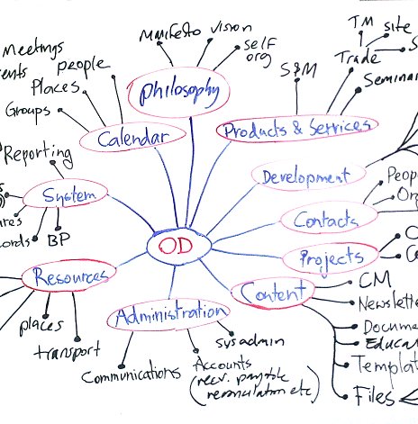
Ontology Engineering
Knowledge-based System Engineering
Intelligent Information Management Laboratory
Laboratorium Manajemen Cerdas Informasi

Slide 2
"If two systems both use the word Student, do they necessarily mean exactly the same thing?"
System A:
Student = someone enrolled in a university
System B:
Student = someone who has paid tuition
System C:
Student = someone with an active student ID
Needs shared conceptualization + explicit semantics

Slide 3
Ontology
An ontology is a formal, explicit specification of a shared conceptualization of a domain.
Explicit: The concepts and relationships are explicitly defined.
Formal: They can be represented in a machine-processable language.
Shared: Different people/systems can use the same conceptual model.

Slide 4
Ontology vs Taxonomy vs Database
 | Taxonomy | Database | Ontology
Main purpose | Classification | Store data | Represent knowledge
Hierarchy | ✓ | Sometimes | ✓
Relationships | Limited | ✓ | ✓
Semantics | Limited | Limited | Strong
Inference | Limited | Usually limited | ✓
Formal logic | Usually no | No | ✓

Slide 5
Example
Course
Course
hasPrerequisite
Course
Mandatory Course
Elective Course
Taxonomy
Ontology

Slide 6
Ontology Components
Relationship between classes or individual
Classes
Object properties
Student
Course
Lecturer
Department
enrolledIn
teaches
belongsTo
hasPrerequisite
Characteristics of classes or individual
Individuals
Data properties
Ahmad
MachineLearning
Dr Budi
Informatics
hasName
hasGPA
hasCredits

Slide 7
Ontology Engineering Process
1. Define Scope
2. Identify Concepts
3. Define Classes
4. Define Class Hierarchy
5. Define Properties
6. Define Restrictions
7. Create Individuals
8. Validate / Reason
9. Refine Ontology

Slide 8
Protégé Practice: University Ontology
University
Person
Course
Department
Student
Lecturer
Object properties:
Student ── enrolledIn ── Course
Lecturer ── teaches ── Course
Course ── belongsTo ── Department
Course ── hasPrerequisite ── Course

Slide 9
Protégé Practice
Complete the University with Data Properties and Individuals to represent course registration

